Slide 1

Generative AI-powered Customer Service Chatbot for Car sales
Eric Williams
Notes:
Eric Williams, final project for sweng 837, and here is my software system design for a car sales chatbot

Slide 2
Introduction
Generative AI-powered Customer Service Chatbot: Design a chatbot system that uses natural language processing and machine learning to provide instant customer support and personalized recommendations.

Slide 3
Design Solution Overview
This system shall provide users with instant customer support using a chatbot that uses natural language processing and machine learning for a car dealership to streamline website interactions for sales, financing, and repairs.
i. Sales prompts the chatbot helps the user find a desired car based on their needs and then forwards the user to a sales representative to the most suitable car dealer with the customer’s information and car model choices.
ii. Financing prompts the chatbot to connect the user to a financing specialist.
iii. Vehicle servicing prompts the user to specify details related to servicing needs and schedule an appointment for the user.
Chatbot shall track usage data and interaction data on the website to measure user engagement and effect on number of sales.
Chatbot shall keep user data secure.
Notes:
Chatbot,
Core responsibilities
Tracking data
Security, keep data personalized but on a user level

Slide 4
Design Patterns
KISS
Simplicity
Flexibility
Usability
YAGNI
Reduce Complexity
Prioritization
Refactoring
Cloud Native Design
Scalability
Platform independence
Fast deployment
Patterns:
Generalization
Description
States
Strategy
Notes:
Here are some key design patterns and concepts I was able to employ, I’ll go into more detail abou this later
Kiss
Yagni
Cloud native
patterns

Slide 5
Detailed Explanation (5-8 minutes):
Use visuals: Utilize diagrams (UML, architecture, etc.) throughout your explanation.
Follow the recommended breakdown:
Problem Statement: Briefly re-emphasize the problem the system aims to solve.
Use Case Diagram: Explain the actors (users, systems) and their interactions with the system.
Activity/Sequence Diagram: Illustrate the business flow or information flow between objects.
Domain Model/Class Diagram: Explain key classes, their attributes, and relationships.
State Chart/Machine Diagram: Explain object state transitions and subsequent actions.
Component Diagram: Describe the system's components and their dependencies.
Architecture Pattern: Explain the chosen architecture (e.g., Layered, Microservices, serverless, distributed) and its justification.
Design Principles & Patterns: Explain how specific principles (SOLID, GRASP, etc.) or patterns (GOF, Cloud Native) influenced your design

Slide 6
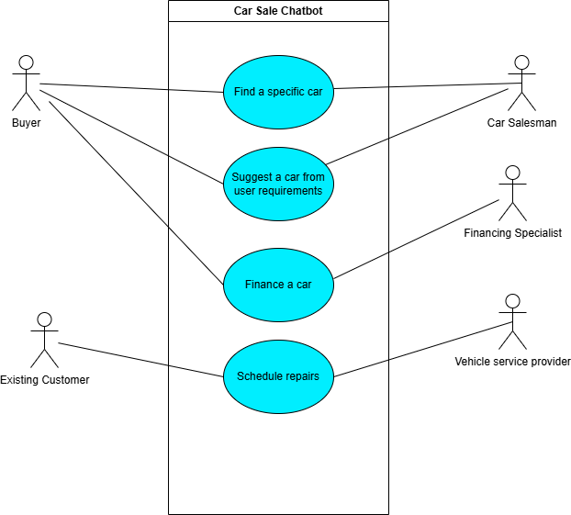
Use Case Diagram
Notes:
4 major uses, two user classes, and 3 secondary actors

Slide 7
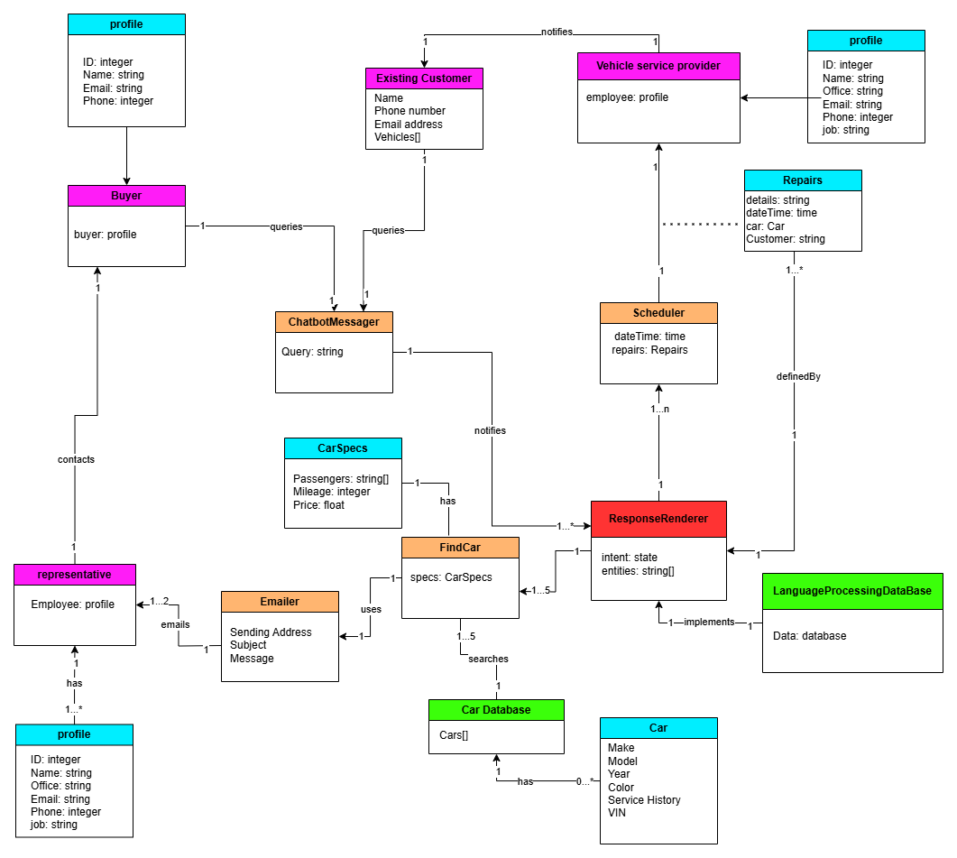
Domain Model
Notes:
List out classes, prune the list, associations, multiplicity 1 2 many, or 1 to many
Verb association

Slide 8
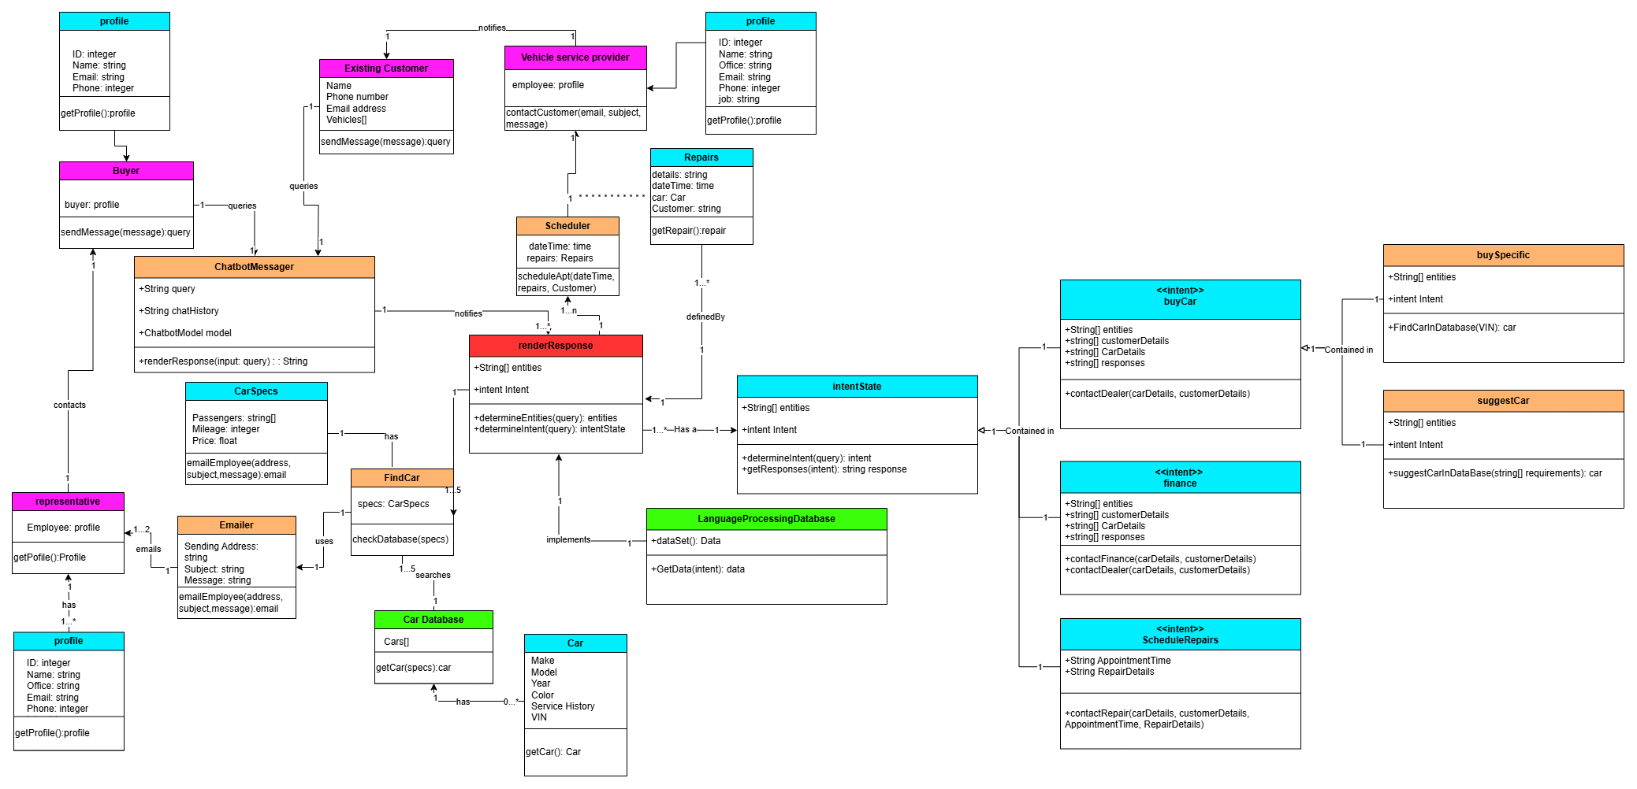
Class Diagram
Notes:
In the document, I went into more detail, but here I wanted to focus in on the different states of customer service the chatbot will focus on handling
Buy car (find specific car or suggest car), finance car, or schedule repairs
You can see some of the methods I added such as contact repair, determine intent, and suggestCarindatabase

Slide 9
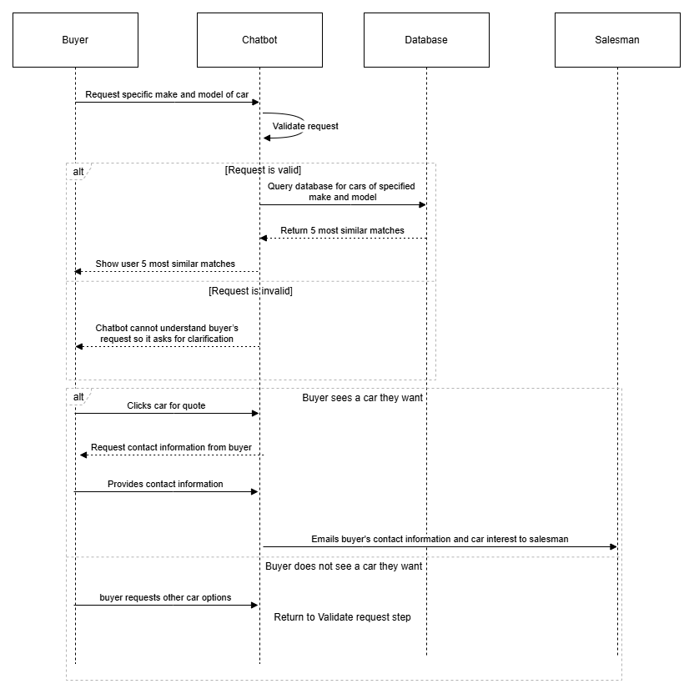
Sequence diagram 1
Notes:
First use case Informed buyer wants to buy a car

Slide 10
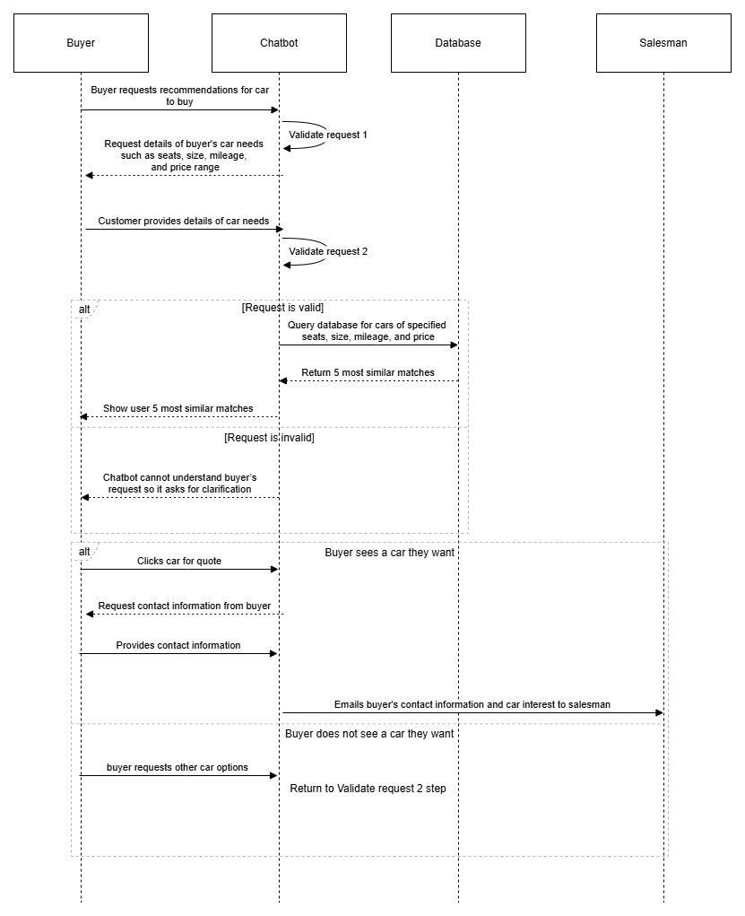
Sequence diagram 2
Notes:
Second use case Undecided buyer wants to buy a car

Slide 11
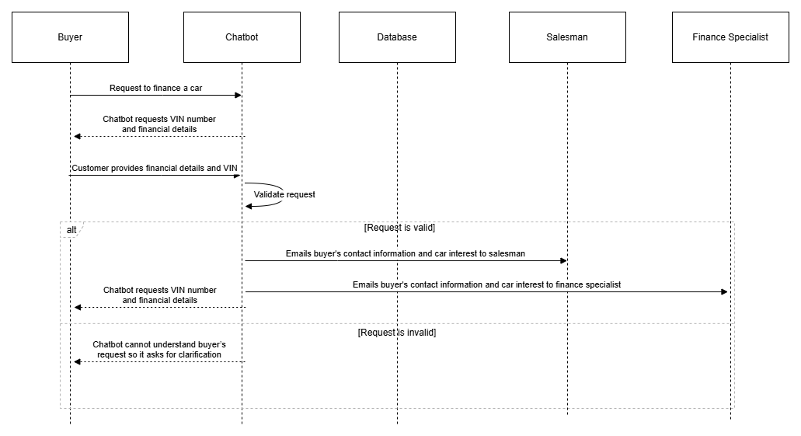
Sequence diagram 3
Notes:
Third use case Buyer wants to finance a car

Slide 12
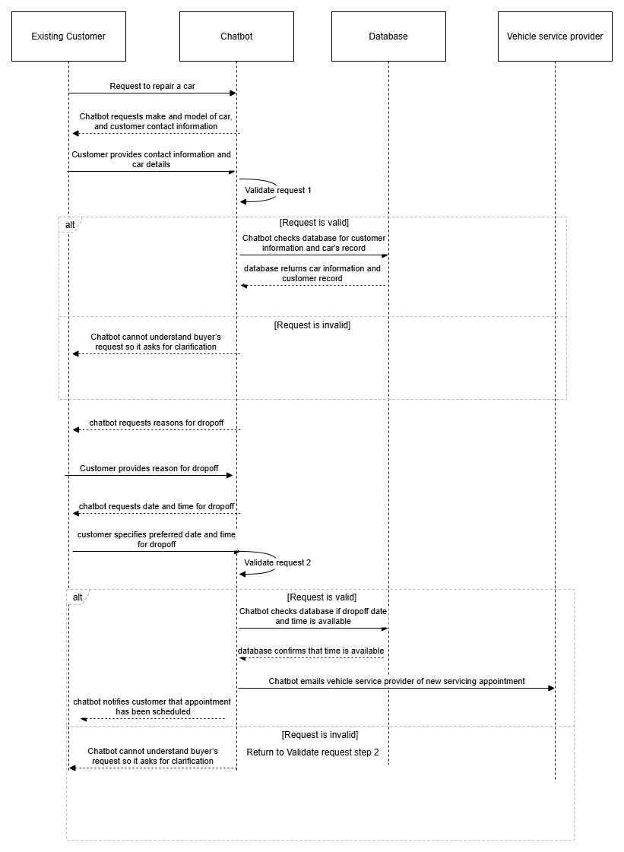
Sequence diagram 4
Notes:
Fourth use case Existing customer wants to get car repaired

Slide 13
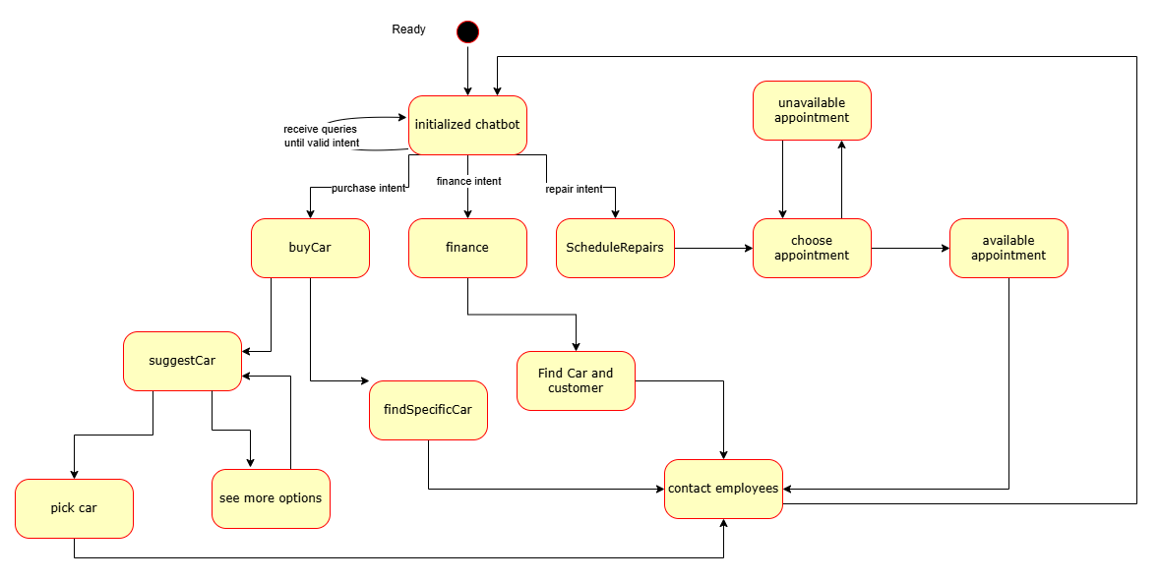
State Diagram
Notes:
the chatbot has to process a variety of potential intents and this is clearly shown by the state diagram. the state diagram has multiple branches like a tree like shape rather than a linear path, which makes sense because we don’t want one of the workflows to be confused with another to increase complexity and make a more complicated user experience

Slide 14
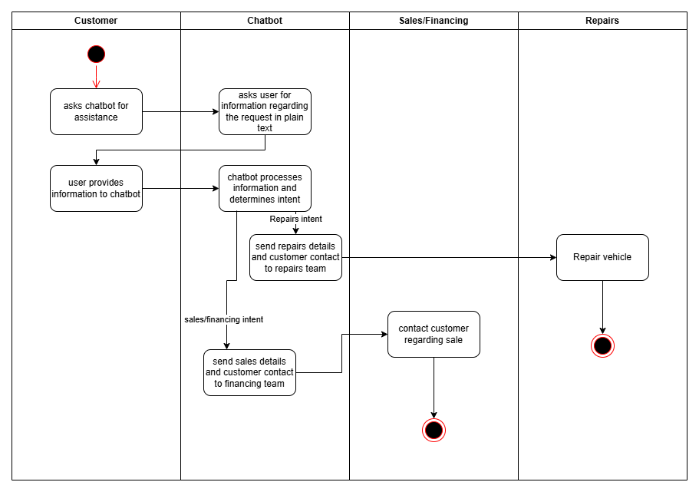
Activity Diagram
Notes:
Customer, chatbot, customer, chatbot, intent, then to sales or repairs

Slide 15
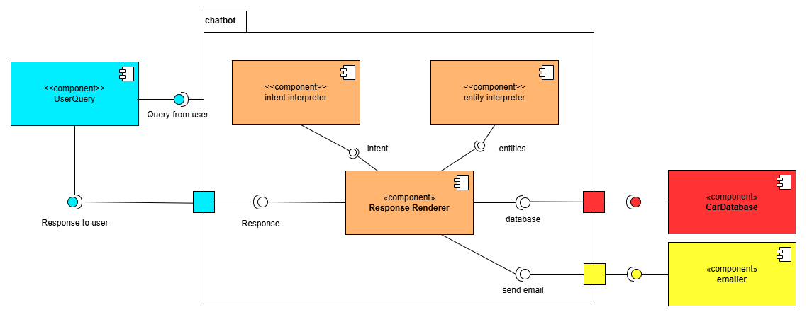
Component Diagram
Notes:
Component diagram for chatbot. It starts with a query, determines intent and entities, and renders a response from the car database and has the ability to email relevant employees

Slide 16
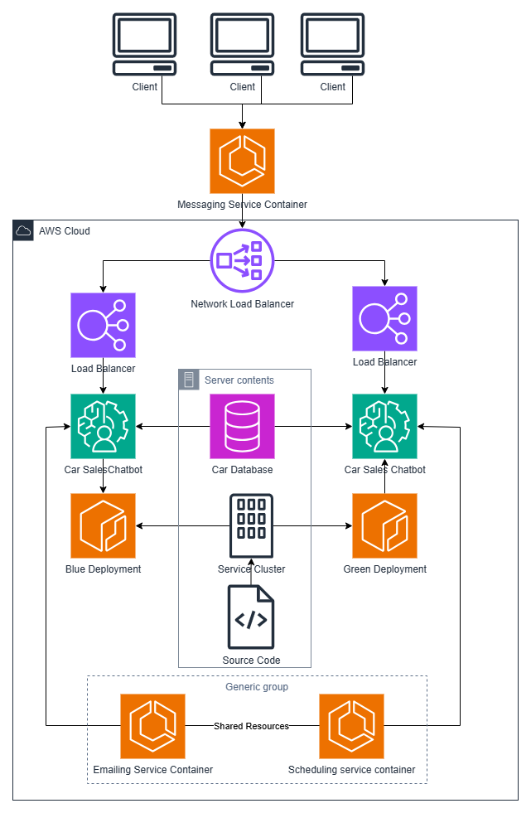
Cloud Deployment Diagram
Notes:
AWS deployment diagram setup with green blue deploytment to ensure maximized uptime for the feature. This is so that customers can reach out to the chatbot even when nobody is online and a quote or sales transaction can be started at any time of the day.

Slide 17
Design Patterns
KISS
Simplicity
Flexibility
Usability
YAGNI
Reduce Complexity
Prioritization
Refactoring
Cloud Native Design
Scalability
Platform independence
Fast deployment
Patterns:
Generalization
Description
States
Strategy
Notes:
Main design principles I wanted to use was to minimize complexity, promote usability and allow code to be refactored down the line. For this chatbot, I could easily see many more features and capabilities to be added later, but since this is just the first iteration of the design I wanted to focus on the core responsibilities and allow for more scalability later after the collected data from the first iteration better shows what our user base wants. Generalization and states were incredibly userful patterns to reduce the complexity of figuring out what a user intent was, refining the scope from figuring out every possible thing a user could want to narrowing it down to 4 identifiable states which can be handled with a respective strategy

Slide 18
Detailed Explanation (5-8 minutes):
Use visuals: Utilize diagrams (UML, architecture, etc.) throughout your explanation.
Follow the recommended breakdown:
Problem Statement: Briefly re-emphasize the problem the system aims to solve.
Use Case Diagram: Explain the actors (users, systems) and their interactions with the system.
Activity/Sequence Diagram: Illustrate the business flow or information flow between objects.
Domain Model/Class Diagram: Explain key classes, their attributes, and relationships.
State Chart/Machine Diagram: Explain object state transitions and subsequent actions.
Component Diagram: Describe the system's components and their dependencies.
Architecture Pattern: Explain the chosen architecture (e.g., Layered, Microservices, serverless, distributed) and its justification.
Design Principles & Patterns: Explain how specific principles (SOLID, GRASP, etc.) or patterns (GOF, Cloud Native) influenced your design

Slide 19
Conclusion and Next Steps
Key takeaways:
Though out this process, it was useful to learn about the design process. At work I often hear the managers using keywords like YAGNI design and now I have a better understanding. One of the biggest costs with planning is taking the time to invest in a plan as at my current job they want constant deliverables which does not allow for much time to plan
Skills and career:
Many of these skills I can see will have direct impact on my ability to plan out projects and design appropriate UML diagrams for a project. They are an effective communication tool, and can mitigate confusion and miscommunication

